Slide 1
Y2025 PDE Div.
J1/J2 Report sharing
Topic: Summary Job Assignment
Half A Year
Presenter: Mr.Sadayu Hakhunthod
Report sharing cover sheet
Notes:
สวัสดีครับ ผมขอนำเสนอ J4 Report sharing ครั้งที่1 ประจำปี 2024 หัวข้อการนำเสนอ Index : Organization ครับ

Slide 2

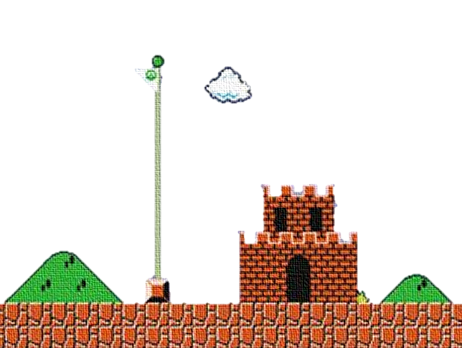
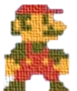
Y2024 PDE Div. J1/J2 Report sharing
Agenda
Next Action
Summary
Job
Job Assignment
J1/J2 PDE Report Sharing Name : Mr.Sadayu Hakhunthod

Slide 3
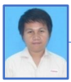
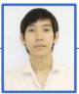
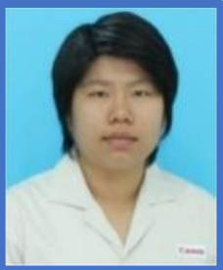
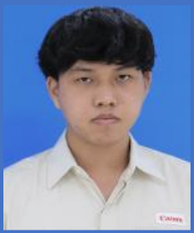
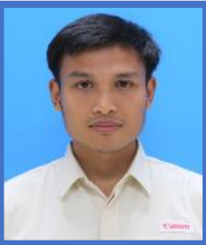
Job Assignment
Image / DX Project (Elec)
Anuwat
(AMGR)
Apiched
(Chief Eng.)
Kanyarat
(Sr.Eng.)
Voraprach
(Eng.)
Sadayu
(Eng.)
2025 Action Plan
Project (4/13)
No. | Project | Status
1 | Spur Sheet Camera Check | Finished
2 | Camera Check Armbands No.1 | Finished
3 | Packing Process Camera Check No.2 | Finished
4 | Packing Process Camera Check No.3 | Finished
5 | Packing Process Camera Check No.4 | Aug
6 | Pulp Mold Camera Check No.2 | Aug
7 | Visual Inspection Part PTQA Model.H24/25 | Aug
8 | Visual Inspection Part PTQA Model.F90 | Sep
9-13 | Camera Check Armbands No.2, 3, 4, 5, 6 | Nov
Index Activity (2/5)
No. | Subject | Status
1 | Standard Modules | Finished
2 | Electric Drawing (Monotsukuri) | Finished
3 | DX New | Aug
4 | Text Book DX | Oct
5 | IT Asset Control | Claim = 0
J1/J2 PDE Report Sharing Name : Mr.Sadayu Hakhunthod

Slide 4

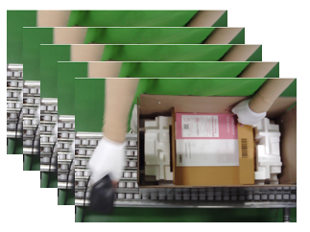


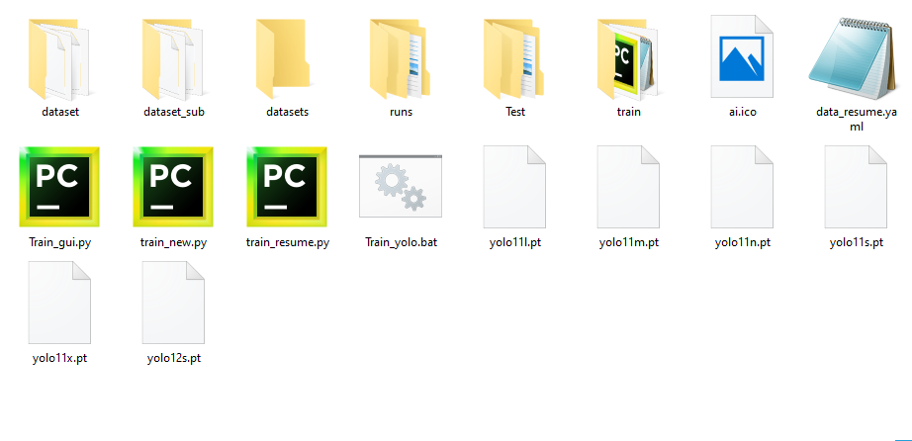
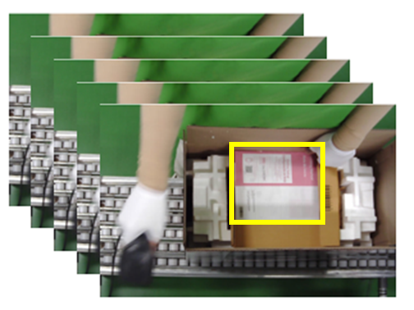
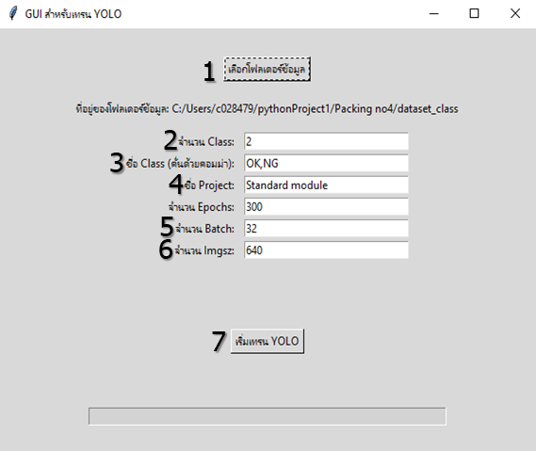
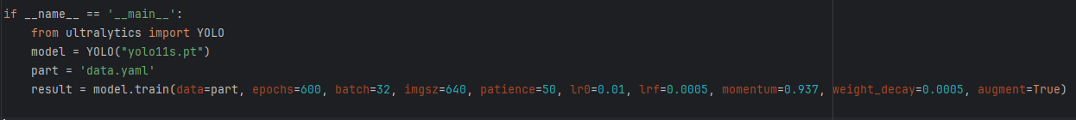
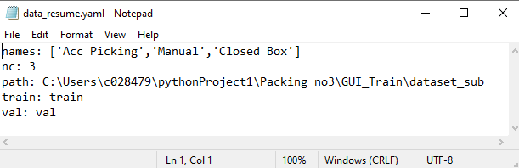







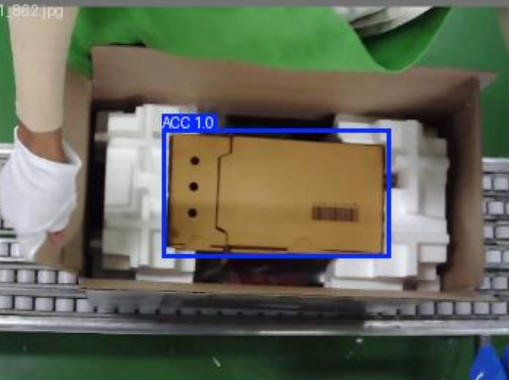
Job (Standard Module DX)
Keep Data
Before
After
Edit Code Setting
GUI Train Ai
Label Data
Train Model
Problem
Advantages
1. Easily editable
2. Shows error messages
3. Accessible to everyone
Coding
An incorrect modification may cause the system to malfunction.
Use
J1/J2 PDE Report Sharing Name : Mr.Sadayu Hakhunthod

Slide 5
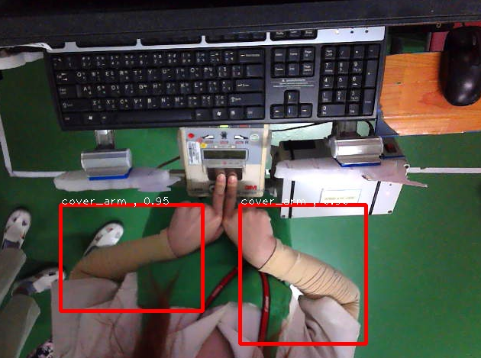
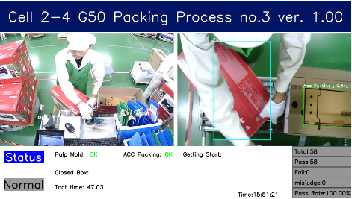
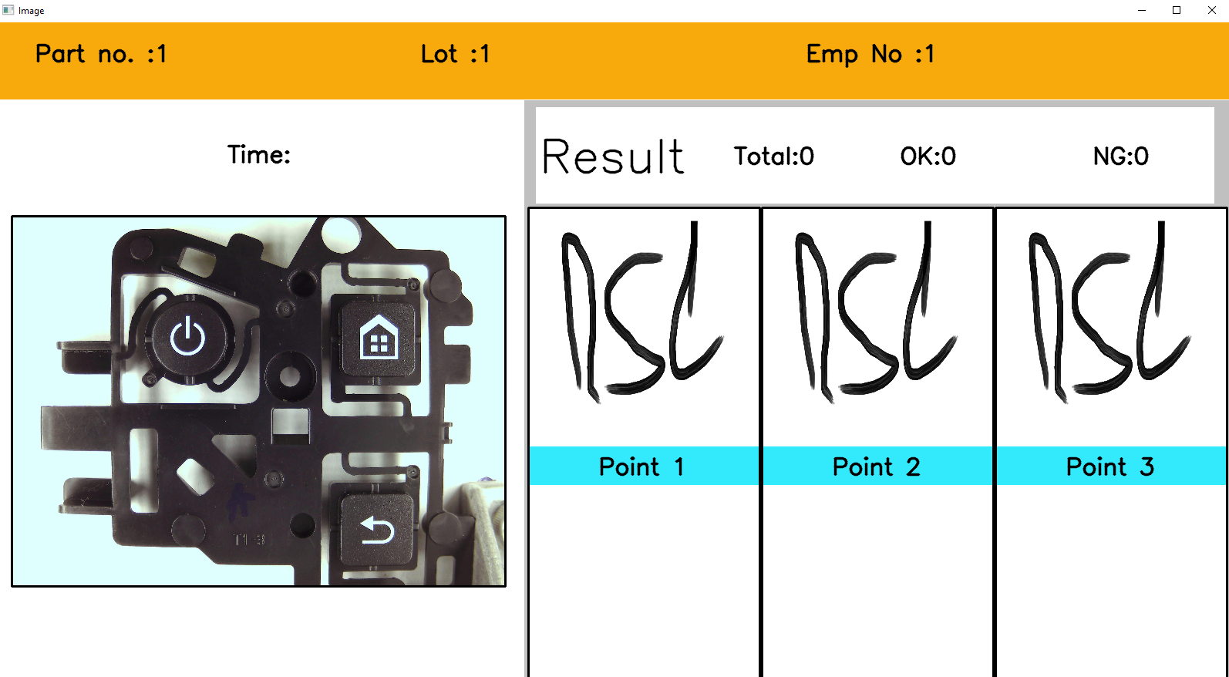
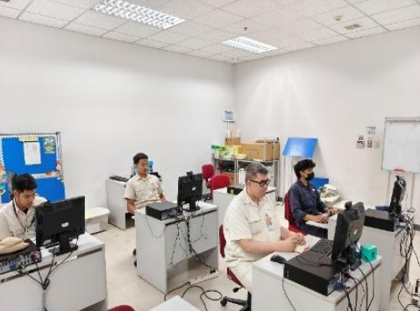
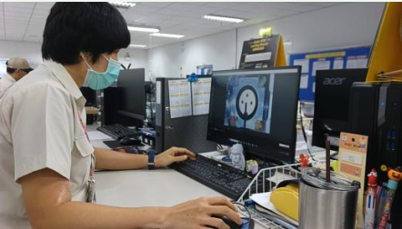


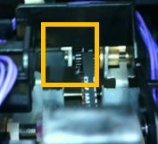
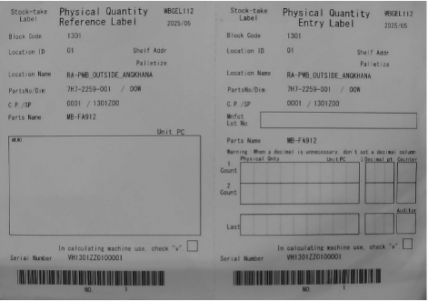
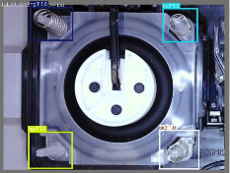
Summary (Standard Module DX)
Use case
Data Use Train AI
1.Develop project
Cover Arm
Packing
Inspection Part
2.Training course
Department
- MFG-3 PCB - PLD DBC
- MFG-2 MA - PDE PDE-FA
- MFG-2 Mold
Saved a total of 114 minutes.
3.Support request job
Clip Lock PDE-RA
Tag card PAD
H50 PDE-FA
J1/J2 PDE Report Sharing Name : Mr.Sadayu Hakhunthod

Slide 6


Next Action
Problem and next action
No. | Problem | cause | Action
1 | There is a need for high usage, but the exact timing is unknown. | There is no time evaluation system. | Add a function to calculate the time used for training the model.
2 | The AI model doesn't detect well and is unstable. | The project is complex. | Prepare a textbook for the DX project to help with model training.
3 | Can't train an AI model that requires high resolution. | The computer doesn't have enough performance to train the AI model. | Upgrade the computer to improve its performance.
J1/J2 PDE Report Sharing Name : Mr.Sadayu Hakhunthod

Slide 7
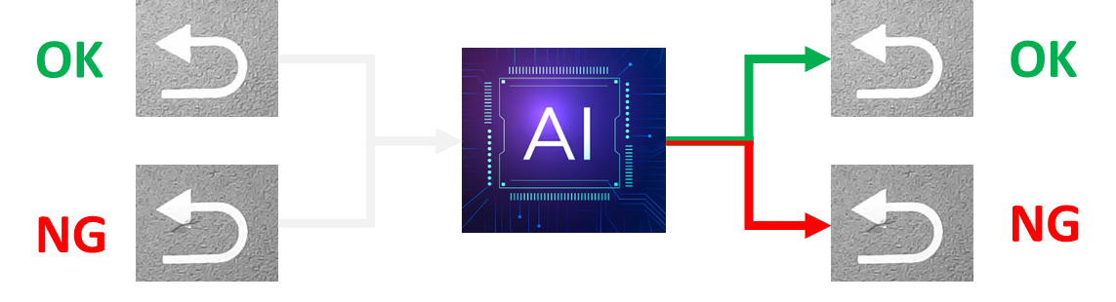
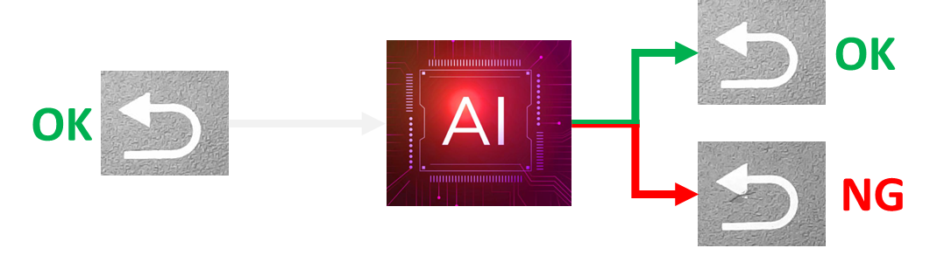
Self Development & New Technology
Self Development
Skill map
New Technology
Current
New Ai
J1/J2 PDE Report Sharing Name : Mr.Sadayu Hakhunthod

Slide 8




END
J1/J2 PDE Report Sharing Name : Mr.Sadayu Hakhunthod

Slide 9


